Slide 1

Google Cloud Fundamentals: An Introduction to Modern Cloud Computing
Exploring the basics and core services of cloud technology
Notes:
--- This presentation provides a comprehensive introduction to Google Cloud and modern cloud computing. We will cover everything from the basics of cloud computing to Google Cloud's core services, security, management tools, and real-world applications.

Slide 2

Agenda Items
Introduction to Google Cloud
Core Google Cloud Services
Security and Compliance
Management and Monitoring Tools
Case Studies and Real-World Applications
Notes:
We will begin by introducing Google Cloud and explaining the fundamentals of cloud computing, including its history and benefits. Next, we will explore core Google Cloud services, focusing on compute, storage, and networking offerings. We will also cover security and compliance measures, management tools, and conclude with case studies showcasing innovative applications.

Slide 3
Introduction to Google Cloud
Notes:
Google Cloud is a powerful platform that offers a range of services for businesses and developers. Understanding its foundations will help us appreciate how it fits within the larger cloud computing ecosystem.

Slide 4
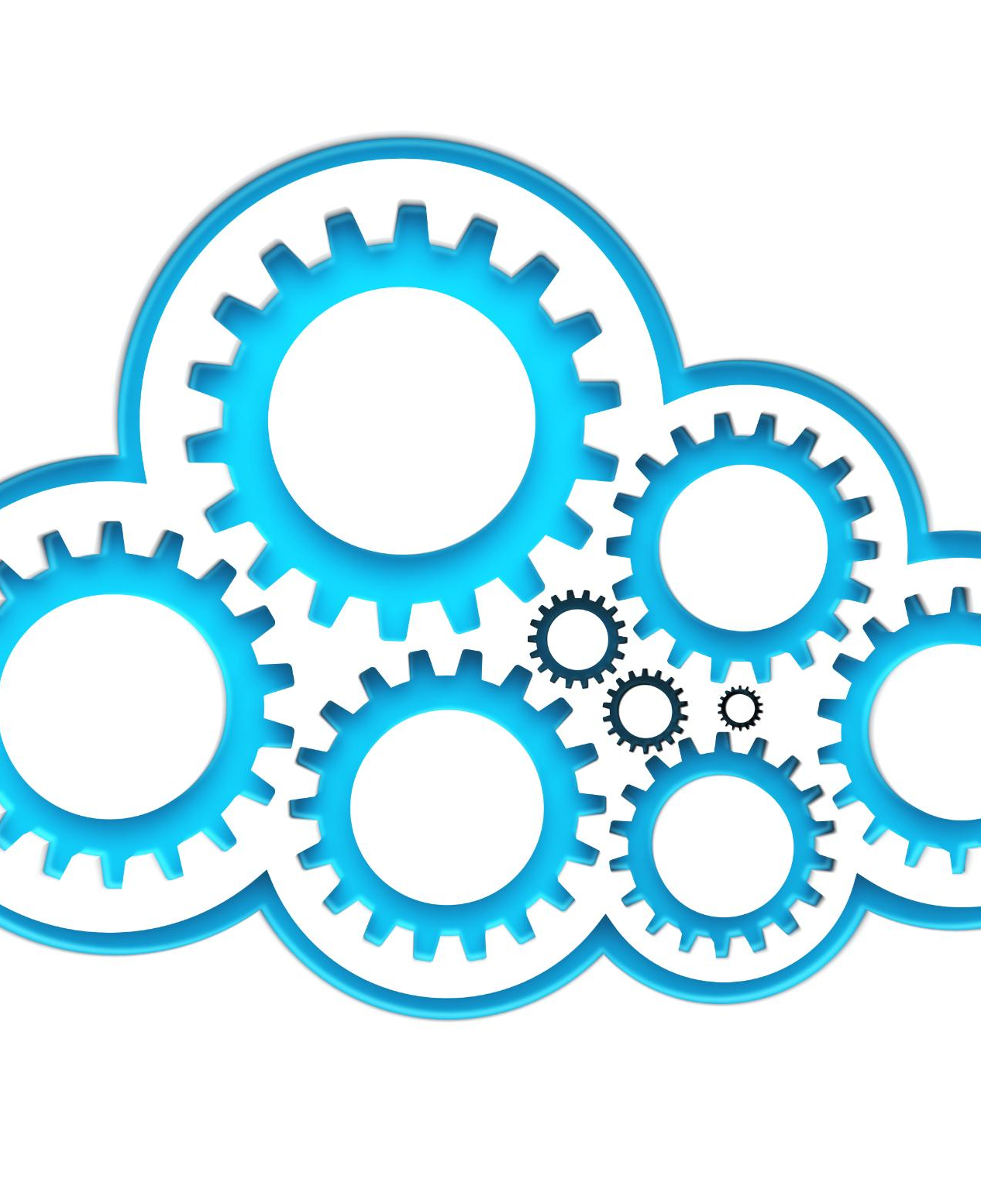
Overview of Cloud Computing
Definition of Cloud Computing
Cloud computing refers to the delivery of computing services over the internet, including data storage and processing.
Benefits of Flexibility
Cloud computing provides users with the flexibility to access data and applications from anywhere with an internet connection.
Scalability and Cost Efficiency
Businesses can scale their resources up or down easily with cloud computing, leading to significant cost savings.
Notes:
Cloud computing allows users to store, manage, and process data over the internet instead of local servers. It offers flexibility, scalability, and cost efficiency, making it an essential component for modern businesses.

Slide 5

History and Evolution of Google Cloud
Inception of Google Cloud
Google Cloud was launched in 2008, marking the beginning of its journey in the cloud services market.
Growth of Services
Over the years, Google Cloud has expanded its offerings to meet the evolving needs of developers and businesses.
Global Impact
Google Cloud's evolution reflects the global demand for efficient cloud solutions, impacting industries worldwide.
Notes:
Google Cloud has evolved significantly since its inception. Launched in 2008, it has grown to offer a comprehensive suite of cloud services, reflecting the needs of developers and enterprises around the globe.

Slide 6

Key Benefits and Advantages
High Performance
Google Cloud offers high-performance computing resources, enhancing efficiency and speed for various applications and workloads.
Security Features
Robust security features in Google Cloud protect sensitive data and ensure compliance, allowing organizations to operate confidently.
Integration with Analytics
Integration with advanced analytics tools allows organizations to gain valuable insights and make data-driven decisions.
Notes:
Google Cloud provides numerous advantages, including high performance, security features, and integration with advanced analytics. These benefits empower organizations to innovate and scale with confidence.

Slide 7
Core Google Cloud Services
Notes:
The breadth of services offered by Google Cloud is essential for developers and companies. Understanding these core services is crucial for leveraging cloud technology effectively.

Slide 8
Compute Engine and Virtual Machines
Virtual Machine Creation
Google Compute Engine enables users to create virtual machines easily on a scalable cloud platform.
Configuration Flexibility
It offers various configuration options, allowing users to choose different operating systems and machine types to suit their needs.
Notes:
Google Compute Engine allows users to create and run virtual machines on Google's infrastructure. It offers flexibility in configuration, with options for different operating systems and machine types.

Slide 9
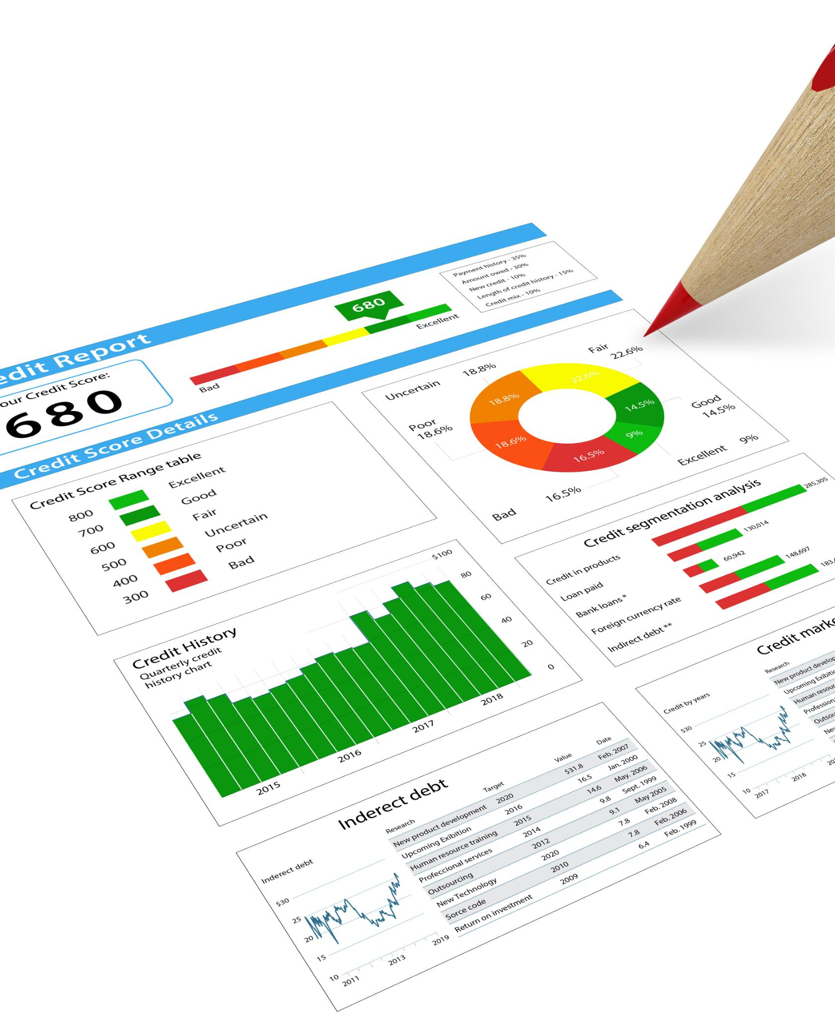
Storage Solutions: Google Cloud Storage, BigQuery, and More
Google Cloud Storage
Google Cloud Storage offers scalable object storage solutions ideal for unstructured data and backups.
BigQuery for Data Analytics
BigQuery provides powerful data analytics capabilities to help organizations gain insights from large datasets efficiently.
Diverse Data Management Solutions
Google Cloud offers a variety of storage and data management solutions to meet diverse business needs.
Notes:
Google Cloud provides robust storage options, including Google Cloud Storage for object storage and BigQuery for data analytics. These solutions cater to various data management needs.

Slide 10
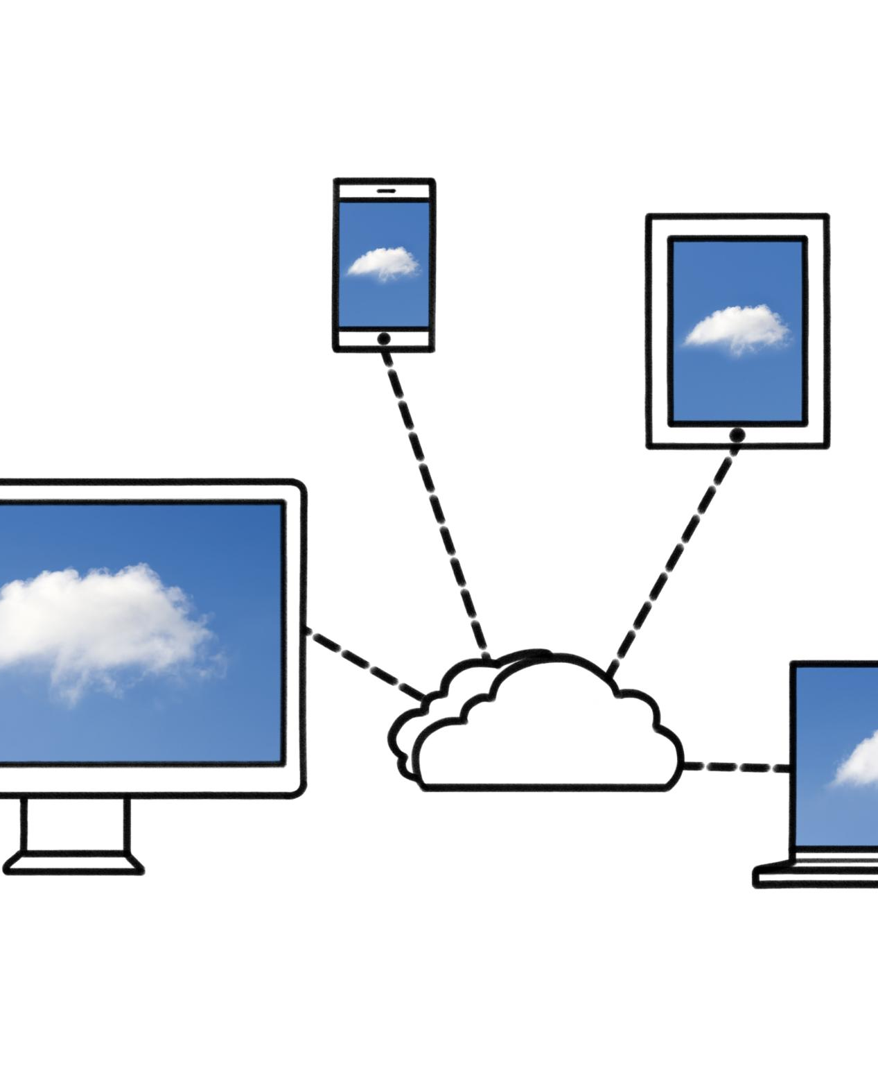
Networking Services: VPC, Cloud CDN, and Cloud DNS
Virtual Private Cloud (VPC)
VPC provides a secure and isolated environment for applications, ensuring scalability and flexibility for cloud resources.
Cloud CDN
Cloud CDN caches content at strategically located edge servers, improving application performance and reducing latency for users.
Cloud DNS
Cloud DNS offers reliable domain name resolution, enhancing application availability and performance for users worldwide.
Notes:
Google's networking services, such as Virtual Private Cloud (VPC), Cloud CDN, and Cloud DNS, ensure that applications can scale efficiently. They enhance performance and reliability for users.

Slide 11
Security and Compliance
Notes:
In the cloud era, security is paramount. Google Cloud places significant emphasis on security features and compliance to protect user data and support industry regulations.

Slide 12

Security Features and Best Practices
Encryption
Encryption is a critical security feature that protects data by converting it into a secure format that can only be read by authorized users.
Identity Management
Effective identity management ensures that only authorized users have access to sensitive data and systems, enhancing overall security.
Monitoring Tools
Monitoring tools track and analyze user activities and system performance, helping to identify potential security threats in real-time.
Best Practices
Following security best practices helps organizations strengthen their defenses against cyber threats and vulnerabilities.
Notes:
Google Cloud implements strong security features, including encryption, identity management, and monitoring tools. Following best practices helps organizations enhance their security posture.

Slide 13

Compliance with Global Standards
Trust in Data Management
Adhering to global compliance standards builds trust in data management practices among organizations and their clients.
Importance for Regulated Industries
Compliance with global standards is essential for industries with strict regulatory requirements, ensuring legal and ethical data handling.
Notes:
Google Cloud adheres to various global compliance standards, ensuring that organizations can trust their data management practices. This compliance is crucial for industries with strict regulatory requirements.

Slide 14

Identity and Access Management
Access Control
IAM enables organizations to define and manage who can access specific resources within their cloud environment.
Security Enforcement
IAM policies are essential for enforcing security by ensuring users only have permissions relevant to their roles.
Resource Management
With IAM, organizations can effectively manage access to cloud resources, enhancing overall security and operational efficiency.
Notes:
Google Cloud's Identity and Access Management (IAM) allows organizations to control who can access resources. IAM policies help enforce security by ensuring that users have the appropriate permissions.

Slide 15
Management and Monitoring Tools
Notes:
Effective management and monitoring are vital for maintaining performance and reliability in cloud environments. Google Cloud provides several tools to aid in these areas.

Slide 16

Google Cloud Console
Web-Based Interface
The Google Cloud Console offers a web-based interface that simplifies cloud resource management for users.
Monitoring Applications
Users can easily monitor their applications and services through the intuitive experience provided by the console.
Controlling Services
The console enables users to control various cloud services effectively, enhancing productivity and resource management.
Notes:
The Google Cloud Console is a web-based interface that allows users to manage their cloud resources easily. It provides an intuitive experience for monitoring and controlling applications and services.

Slide 17

Cloud Monitoring and Logging
Performance Tracking
Google Cloud provides tools to effectively track performance metrics across applications, ensuring optimal functionality and user experience.
Event Logging
Logging events is crucial for diagnosing issues within applications. Google Cloud's logging tools help capture and analyze these events efficiently.
Issue Diagnosis
Using monitoring tools, developers can quickly diagnose issues that arise, allowing for swift resolutions and minimizing downtime.
Notes:
Google Cloud offers monitoring and logging tools to track performance metrics and log events. These tools are essential for diagnosing issues and optimizing applications.

Slide 18
Cloud Deployment Manager
Resource Management
The Cloud Deployment Manager allows users to efficiently create and manage cloud resources using configuration files.
Simplified Deployment
This tool simplifies the deployment process, making it easier for users to manage their cloud infrastructure.
Notes:
The Cloud Deployment Manager enables users to create and manage cloud resources with configuration files. This tool simplifies resource management and deployment processes.

Slide 19
Case Studies and Real-World Applications
Notes:
Understanding how organizations utilize Google Cloud can provide valuable insights. We will examine successful case studies and explore applications across various industries.

Slide 20

Successful Implementations by Major Companies
Enhanced Operations
Many companies have leveraged Google Cloud to improve operational efficiency and streamline processes effectively.
Case Studies Overview
Various case studies showcase how organizations benefited from Google Cloud solutions across different sectors.
Benefits of Google Cloud
Implementing Google Cloud offers scalability, reliability, and innovative services that enhance business performance.
Notes:
Many major companies have successfully implemented Google Cloud solutions to enhance their operations. These case studies highlight the capabilities and benefits of using Google Cloud.

Slide 21

Industry-Specific Use Cases
Healthcare Applications
Google Cloud provides healthcare solutions that enhance patient care, data management, and research capabilities in the medical field.
Financial Solutions
In finance, Google Cloud helps organizations to improve data security, compliance, and financial analytics, driving better decision-making.
Manufacturing Efficiency
Manufacturers use Google Cloud to optimize supply chains, enhance operational efficiency, and leverage IoT technologies for real-time monitoring.
Notes:
Different industries leverage Google Cloud for unique applications. From healthcare to finance, these use cases demonstrate the versatility of cloud solutions in addressing specific challenges.

Slide 22

Innovative Solutions and Future Trends
Continuous Innovation
Google Cloud is dedicated to continuous innovation, regularly introducing new solutions to address evolving technology demands.
Emerging Technology Needs
Identifying and adapting to emerging technology needs is crucial for leveraging the full potential of cloud solutions.
Future Trends Awareness
Staying informed about future trends helps businesses maximize the benefits of cloud solutions and stay competitive.
Notes:
As technology evolves, Google Cloud continues to innovate, introducing new solutions to meet emerging needs. Staying informed on future trends is essential for maximizing cloud benefits.

Slide 23
Conclusion
Overview of Google Cloud
This presentation highlighted the essential aspects of Google Cloud, showcasing its core services and functionalities.
Security Features
Understanding the security features of Google Cloud is vital for protecting data and applications in the cloud.
Management Tools
Google Cloud offers various management tools that aid users in managing resources and optimizing performance effectively.
Real-World Applications
Real-world applications of Google Cloud demonstrate its versatility and effectiveness in various industries.
Notes:
In summary, this presentation provided an overview of Google Cloud, its core services, security features, management tools, and real-world applications. Understanding these elements is crucial for leveraging modern cloud computing effectively.

